Slide 1


Karachi AQI Predictor ☁️
An Automated MLOps Solution for Real-Time Air Quality Forecasting
Muhammad Owais Zia
Python
Streamlit
Hopsworks
GitHub Actions

Slide 2


THE PROBLEM: AIR VOLATILITY
Karachi's air quality is highly volatile and often reaches hazardous levels.
Existing apps focus on current status, leaving citizens without actionable future data.
The Goal: Create a system that predicts AQI 72 hours in advance to enable proactive planning.

Slide 3







END-TO-END MLOPS ARCHITECTURE
Ingestion
Storage
Training
Serving
Python scripts fetch data from Open-Meteo API every hour automatically.
Feature Store (Hopsworks) manages versioned data for training and serving.
GitHub Actions triggers daily retraining to keep models fresh with recent data.
Streamlit dashboard provides an intuitive interface for real-time predictions.

Slide 4


SELF-HEALING PIPELINE
The Challenge
API failures and network drops frequently disrupt data flows in production.
The Engineering Solution
Retry Logic: Intelligent 3-attempt backoff (5s intervals).
Automation: Hourly Cron Schedule (0 * * * *) via GitHub.
Uptime without manual intervention

Slide 5





FEATURE STORE ENGINEERING
Why Hopsworks?
Challenge Solved
Crucial for preventing Training-Serving Skew by ensuring identical data pipelines for both offline research and online inference.
Eliminated schema mismatches by enforcing strict data types and column naming conventions at the storage layer.
Store Historical Data (Backfill)
Append Live Data (Hourly)

Slide 6
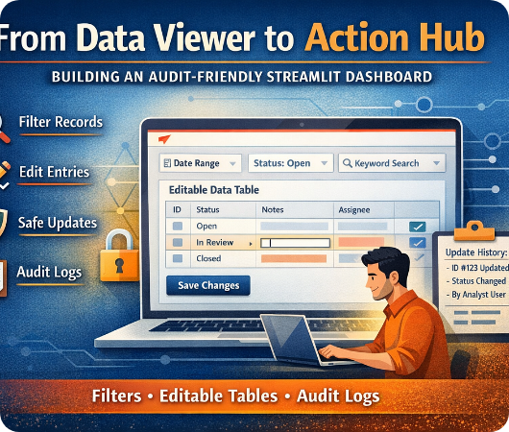
ENTERPRISE UI DESIGN
Transitioning from a "script" to a Production Product.
3-Day Outlook: Card-based UI showing expected range (Low/High).
Interactive Visualization: Plotly charts comparing historical vs. predicted trends.
Responsive Layout: Seamless experience across Mobile and Desktop.

Slide 7






SYSTEM LIVE VALIDATION
Automation
Real-Time
Forecasting
GitHub Actions "Green Checkmark" monitoring active.
Live Badge active on the Streamlit cloud dashboard.
Accurate 3-Day prediction cards generated hourly.

Slide 8

CONCLUSION & ROADMAP
Success
Successfully deployed a fully automated, zero-maintenance ML system for public health utility.
Future Expansion
Integrate Traffic Data and Wind Direction.
Scale to Lahore & Islamabad.
Automated AQI Alert System via Email/SMS.

Slide 9


Thank You!
Any Questions?
muhammad-owais-zia // mlops-solutions

